Slide 1
Application of discrete mathematics in CSE

Slide 2
What is Discrete Mathematics ?
Discrete mathematics is mathematics that deals with discrete objects.Discrete objects are those which are separated from each other. Integers , rational numbers , automobiles , houses , people etc are all discrete objects.

Slide 3
Theoretical Computer Science
Theoretical computer science includes area of discrete mathematics relevant to computing.
Theoretical computer science also includes the study of various continuous computational objects.

Slide 4

Information Theory :
Information theory involves the qualification of information. Closely related is coding theory which is used to design efficient and reliable data transmission and storage methods . Here is a simple circle of continuous topics.

Slide 5
Mathematical Logic :
Logic is the study of the principles of valid reasoning and inference.
The study of mathematical proof is particularly important in logic , and has applications to automated theorem proving and formal verification of software.

Slide 6
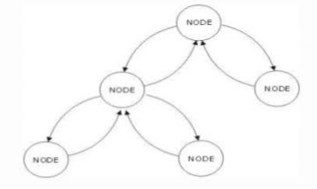
Graph Theory :
Graph theory , the study of graphs and networks , is often considered part of combinatorics. In computer science , they can represent networks of communication , data organisation , computational devices , the flow of computation etc.
There are also continuous graphs like :

Slide 7
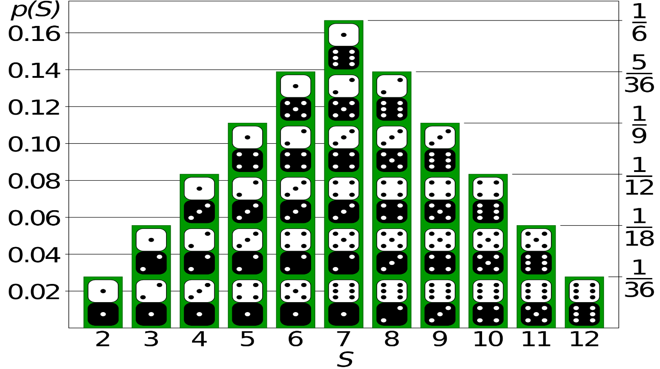
Discrete Probability Theorem :
Discrete probability theory deals with events that occur in countable sample spaces. Discrete probability distributions can be used to approximate continous ones and vice versa. For highly constrained situations like dics or calculating the probability of events is basically enumerative.

Slide 8
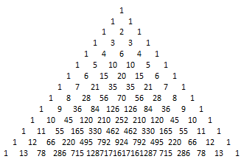
Number Theory :
Number theory is concerned with the properties of numbers in general , particularly integers. Boolean algebra used in logic gates and programming ; relational algebra used in databases ; discrete and finite versions in algebraic coding theory.

Slide 9
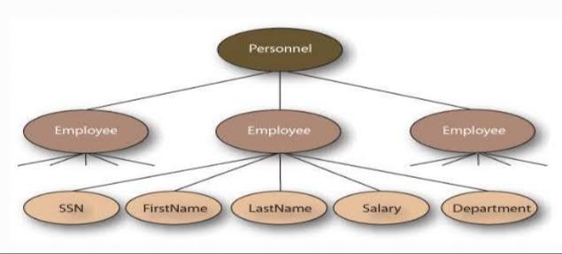
Trees :
Trees are used to represent data that has some hierarchical relationship among the data elements.
Here is a smile diagram of a tree :

Slide 10
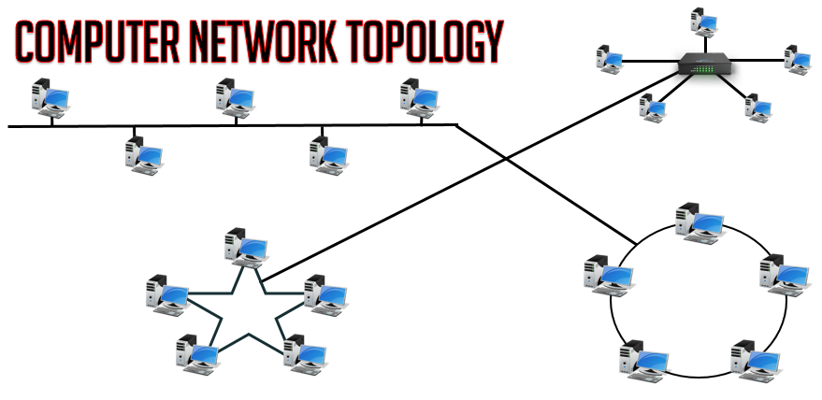
Topology :
Although topology is the field of mathematics that formalizes and generalizes the intuitive notion.
See topological graph theory , discrete topological space , finite topological space , topology.

Slide 11
Everyday Applications of Discrete Mathematics
Computers
The software and files are both stored as huge strings of 1s and 0s. Binary math is discrete mathematics.
Google Maps
It uses discrete mathematics to determine fastest driving routes and times.
Cryptography
Encryption and decryption are part of cryptography, which is part of discrete mathematics. For example, secure internet shopping uses public-key cryptography.
Digital image processing
It uses discrete mathematics to merge images or apply filters.

Slide 12
Conclusions :
We emphasize the essential role that mathematics plays in the development of computer science both for the particular knowledge and for the reasoning skills associated with mathematical maturity.

Slide 13
THANK YOU
Vivek Raju Jadhav
Venkatesh Dhongadi
Sumeet Bafna
Vivek Valagadde

Slide 14

Add a Slide Title - 2
ANY
QUESTIONS????

